Slide 1
Linear Regression
C.1

Slide 2
Curve fitting
Given a set of points:
  experimental data
  tabular data
  etc.
Fit a curve (surface) to the points so that we can easily evaluate f(x) at any x of interest.
If x within data range
➔ interpolating (generally safe)
If x outside data range
➔extrapolating (often dangerous)

Slide 3
Curve fitting
Two main methods :
1. Least-Squares Regression
    Function is "best fit" to data.
    Does not necessarily pass through points.
    Used for scattered data (experimental)
    Can develop models for analysis/design.
2. Interpolation
    Function passes through all (or most) points.
    Interpolates values of well-behaved (precise) data or for geometric design.
interpolation
extrapolation

Slide 4






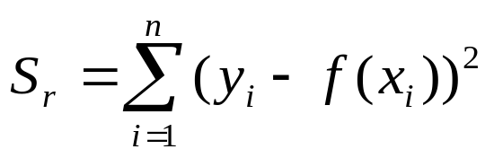

What is Regression?
What is regression? Given n data points
best fit
to the data. The best fit is generally based on
minimizing the sum of the square of the residuals,
.
Residual at a point is
Sum of the square of the residuals
Figure. Basic model for regression

Slide 5








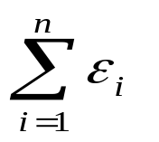

Linear Regression-Criterion#1
Given n data points
best fit
to the data.
y
x
Figure. Linear regression of y vs. x data showing residuals at a typical point, x_{i} .
Does minimizing
work as a criterion, where

Slide 6
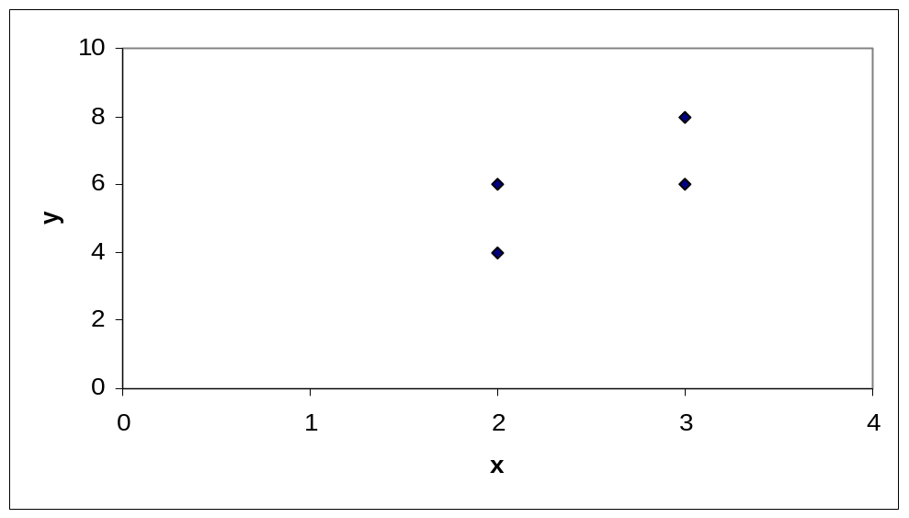
Example for Criterion#1
Example: Given the data points (2,4), (3,6), (2,6) and (3,8), best fit the data to a straight line using Criterion#1
Table. Data Points
x | y
2.0 | 4.0
3.0 | 6.0
2.0 | 6.0
3.0 | 8.0
Figure. Data points for y vs. x data.

Slide 7
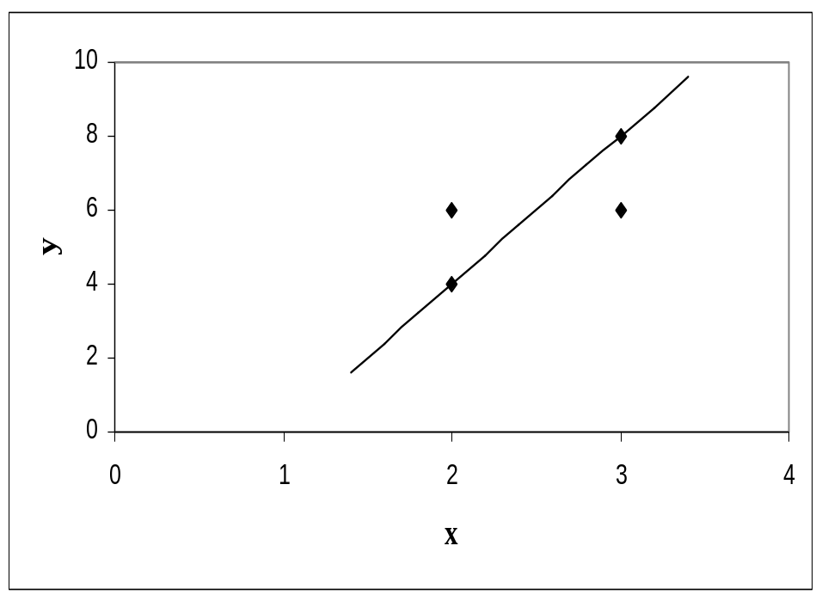
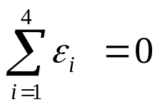
Linear Regression-Criteria#1
Using y=4x-4 as the regression curve
Table. Residuals at each point for regression model y = 4x – 4.
x | y | y_{predicted} | ε = y - y_{predicted}
2.0 | 4.0 | 4.0 | 0.0
3.0 | 6.0 | 8.0 | -2.0
2.0 | 6.0 | 4.0 | 2.0
3.0 | 8.0 | 8.0 | 0.0
Figure. Regression curve for y=4x-4, y vs. x data

Slide 8
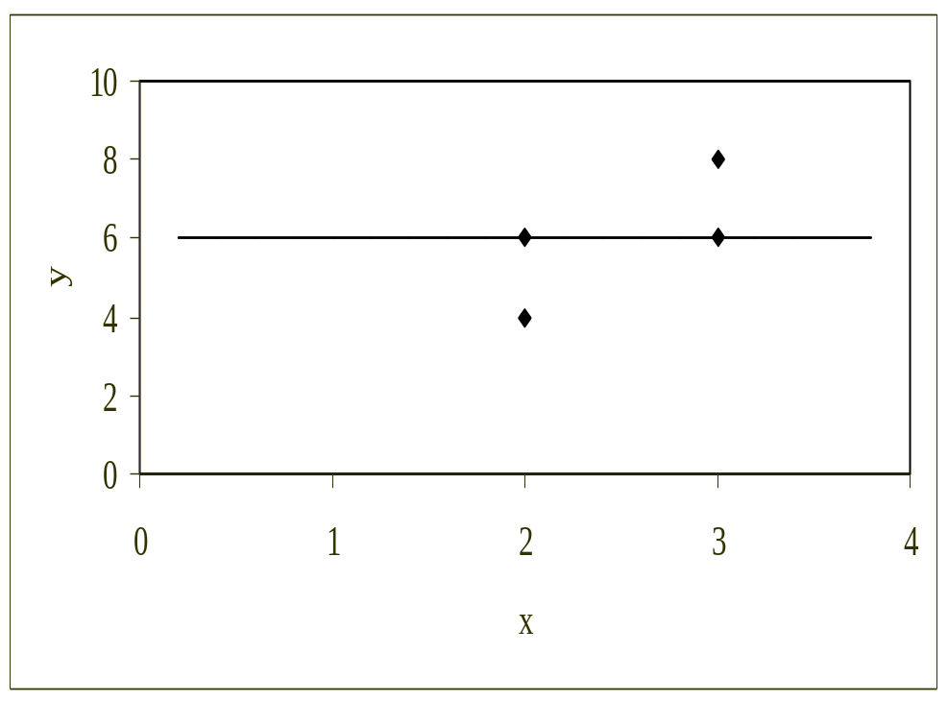
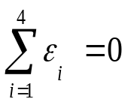
Linear Regression-Criteria#1
Using y=6 as a regression curve
Table. Residuals at each point for y=6
x | y | y_{predicted} | ε = y - y_{predicted}
2.0 | 4.0 | 6.0 | -2.0
3.0 | 6.0 | 6.0 | 0.0
2.0 | 6.0 | 6.0 | 0.0
3.0 | 8.0 | 6.0 | 2.0
Figure. Regression curve for y=6, y vs. x data

Slide 9
Linear Regression – Criterion #1
for both regression models of y=4x-4 and y=6.
The sum of the residuals is as small as possible, that is zero, but the regression model is not unique.
Hence the above criterion of minimizing the sum of the residuals is a bad criterion.

Slide 10
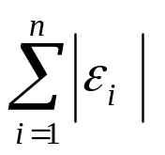
Linear Regression-Criterion#2
Will minimizing
work any better?
y
x
Figure. Linear regression of y vs. x data showing residuals at a typical point, x_{i} .

Slide 11
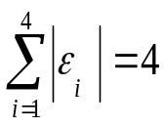
Linear Regression-Criteria 2
Using y=4x-4 as the regression curve
Table. The absolute residuals employing the y=4x-4 regression model
x | y | y_{predicted} | |ε| = |y - y_{predicted}|
2.0 | 4.0 | 4.0 | 0.0
3.0 | 6.0 | 8.0 | 2.0
2.0 | 6.0 | 4.0 | 2.0
3.0 | 8.0 | 8.0 | 0.0
Figure. Regression curve for y=4x-4, y vs. x data

Slide 12
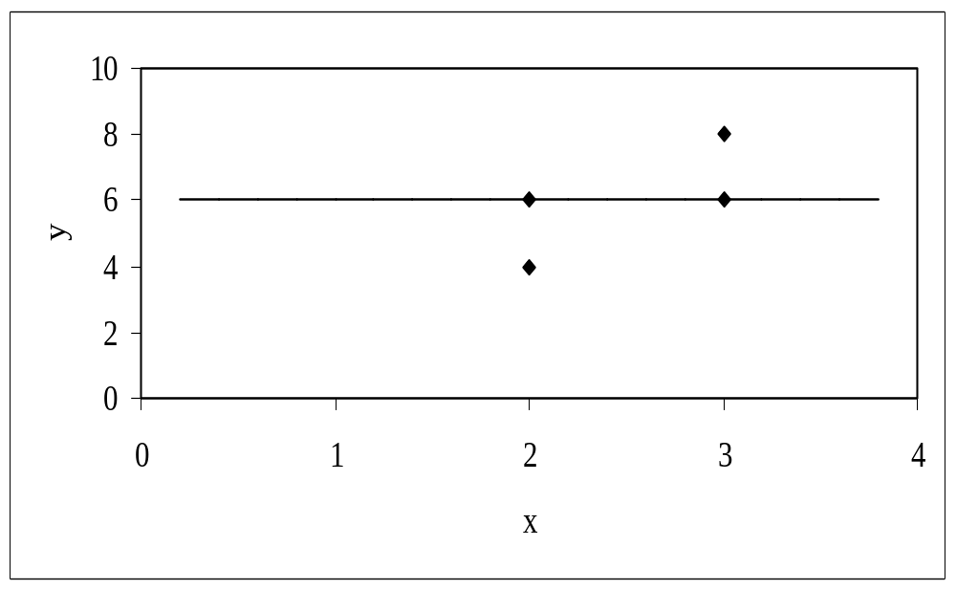
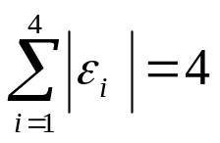
Linear Regression-Criteria#2
Using y=6 as a regression curve
Table. Absolute residuals employing the y=6 model
x | y | y_{predicted} | |ε| = |y – y_{predicted}|
2.0 | 4.0 | 6.0 | 2.0
3.0 | 6.0 | 6.0 | 0.0
2.0 | 6.0 | 6.0 | 0.0
3.0 | 8.0 | 6.0 | 2.0
Figure. Regression curve for y=6, y vs. x data

Slide 13
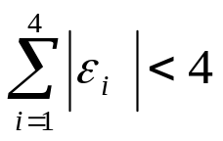
Linear Regression-Criterion#2
for both regression models of y=4x-4 and y=6.
The sum of the errors has been made as small as possible, that is 4, but the regression model is not unique.
Hence the above criterion of minimizing the sum of the absolute value of the residuals is also a bad criterion.
Can you find a regression line for which
and has unique
regression coefficients?

Slide 14
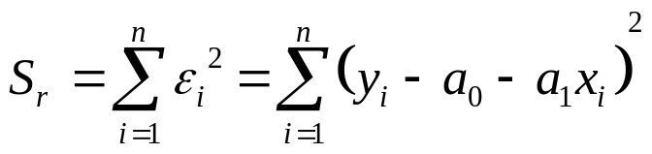
Least Squares Criterion
The least squares criterion minimizes the sum of the square of the residuals in the model, and also produces a unique line.
y
x
Figure. Linear regression of y vs. x data showing residuals at a typical point, x_{i} .

Slide 15




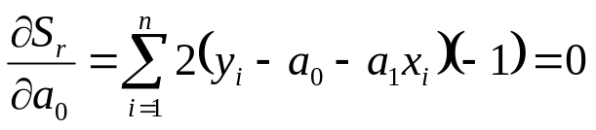
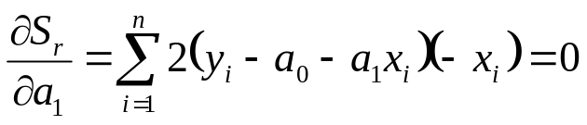
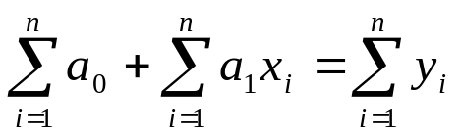
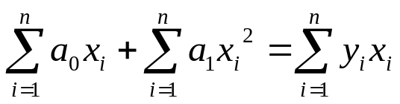

Finding Constants of Linear Model
Minimize the sum of the square of the residuals:
To find
and
we minimize
with respect to
and
.
giving

Slide 16


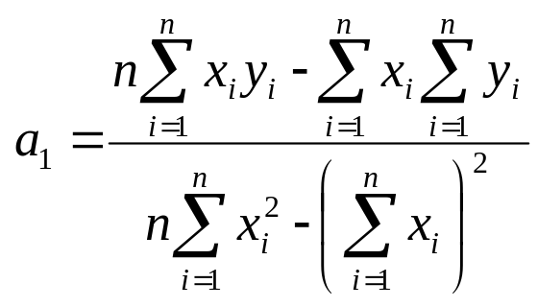
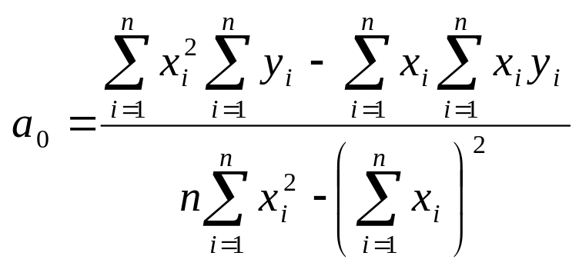

Finding Constants of Linear Model
Solving for
and
directly yields,
and

Slide 17

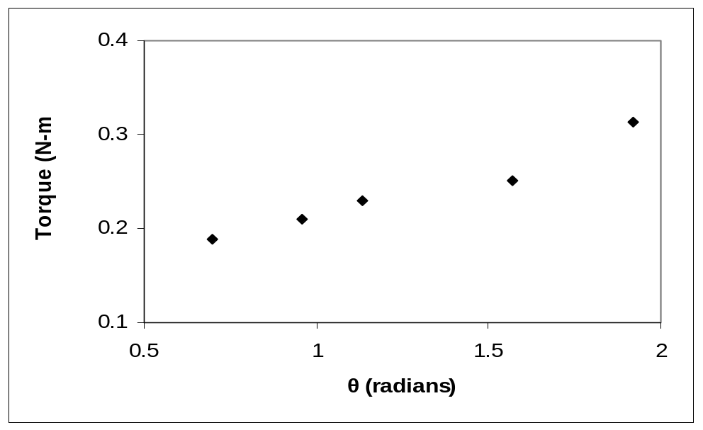
Example 1
The torque, T needed to turn the torsion spring of a mousetrap through an angle, is given below.
Find the constants for the model given by
Table: Torque vs Angle for a torsional spring
Angle, θ | Torque, T
Radians | N-m
0.698132 | 0.188224
0.959931 | 0.209138
1.134464 | 0.230052
1.570796 | 0.250965
1.919862 | 0.313707
Figure. Data points for Angle vs. Torque data

Slide 18






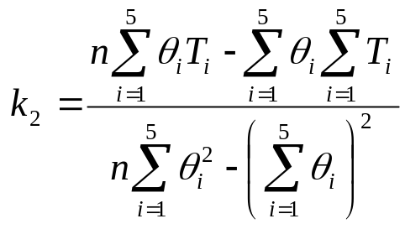
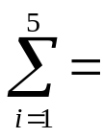
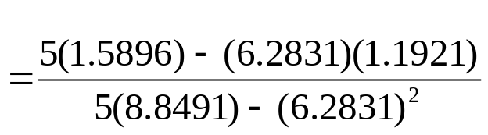

Example 1 cont.
The following table shows the summations needed for the calculations of the constants in the regression model.
Table. Tabulation of data for calculation of important
summations
Radians | N-m | Radians² | N-m-Radians
0.698132 | 0.188224 | 0.487388 | 0.131405
0.959931 | 0.209138 | 0.921468 | 0.200758
1.134464 | 0.230052 | 1.2870 | 0.260986
1.570796 | 0.250965 | 2.4674 | 0.394215
1.919862 | 0.313707 | 3.6859 | 0.602274
6.2831 | 1.1921 | 8.8491 | 1.5896
Using equations described for
and
with
N-m/rad

Slide 19

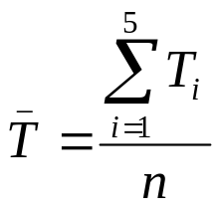
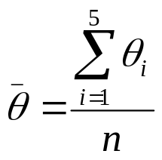
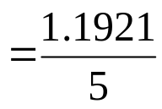
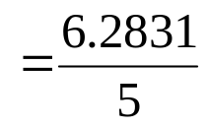


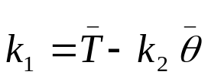

Example 1 cont.
Use the average torque and average angle to calculate
Using,
N-m

Slide 20
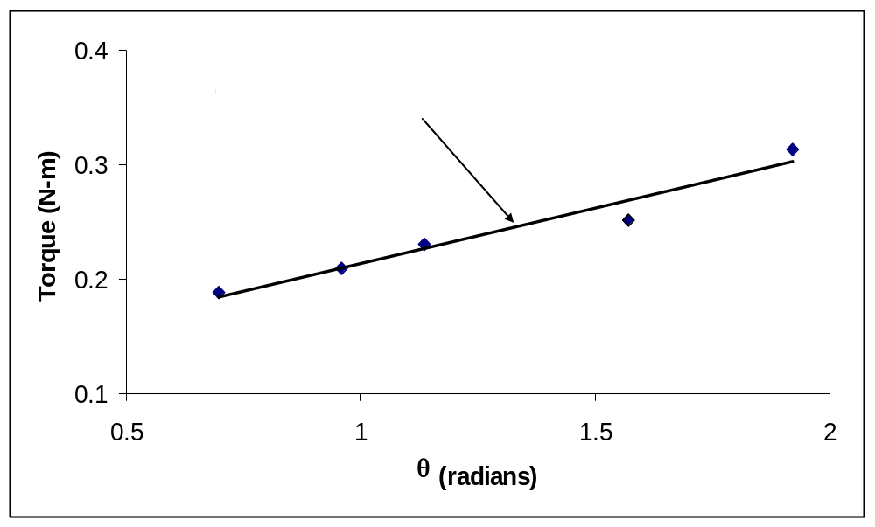
Example 1 Results
Using linear regression, a trend line is found from the data
Figure. Linear regression of Torque versus Angle data

Slide 21


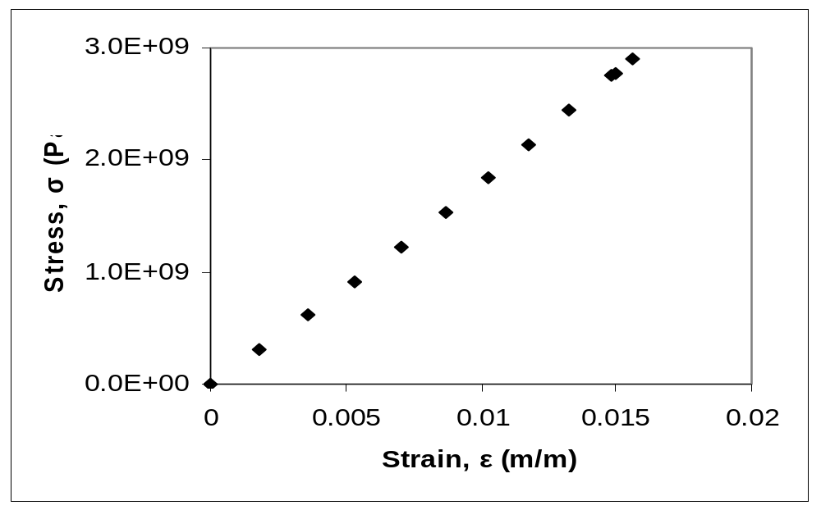
Example 2
To find the longitudinal modulus of composite, the following data is collected. Find the longitudinal modulus,
using the regression model
and the sum of the square of the
Table. Stress vs. Strain data
residuals.
Strain | Stress
(%) | (MPa)
0 | 0
0.183 | 306
0.36 | 612
0.5324 | 917
0.702 | 1223
0.867 | 1529
1.0244 | 1835
1.1774 | 2140
1.329 | 2446
1.479 | 2752
1.5 | 2767
1.56 | 2896
Figure. Data points for Stress vs. Strain data

Slide 22

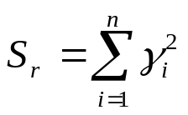
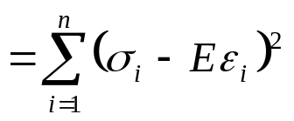

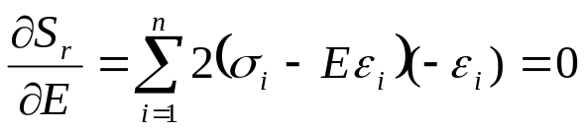
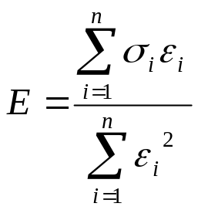
Example 2 cont.
Residual at each point is given by
The sum of the square of the residuals then is
Differentiate with respect to
Therefore

Slide 23
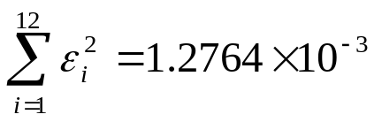
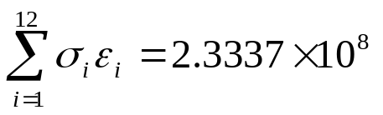
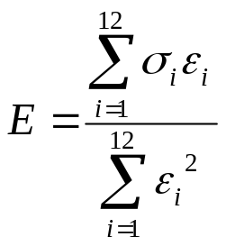
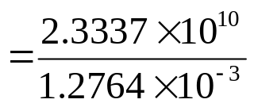


Example 2 cont.
Table. Summation data for regression model
With
i | ε | σ | ε ² | εσ
1 | 0.0000 | 0.0000 | 0.0000 | 0.0000
2 | 1.8300x10⁻³ | 3.0600x10⁸ | 3.3489x10⁻⁶ | 5.5998x10⁵
3 | 3.6000x10⁻³ | 6.1200x10⁸ | 1.2960x10⁻⁵ | 2.2032x10⁶
4 | 5.3240x10⁻³ | 9.1700x10⁸ | 2.8345x10⁻⁵ | 4.8821x10⁶
5 | 7.0200x10⁻³ | 1.2230x10⁹ | 4.9280x10⁻⁵ | 8.5855x10⁶
6 | 8.6700x10⁻³ | 1.5290x10⁹ | 7.5169x10⁻⁵ | 1.3256x10⁷
7 | 1.0244x10⁻² | 1.8350x10⁹ | 1.0494x10⁻⁴ | 1.8798x10⁷
8 | 1.1774x10⁻² | 2.1400x10⁹ | 1.3863x10⁻⁴ | 2.5196x10⁷
9 | 1.3290x10⁻² | 2.4460x10⁹ | 1.7662x10⁻⁴ | 3.2507x10⁷
10 | 1.4790x10⁻² | 2.7520x10⁹ | 2.1874x10⁻⁴ | 4.0702x10⁷
11 | 1.5000x10⁻² | 2.7670x10⁹ | 2.2500x10⁻⁴ | 4.1505x10⁷
12 | 1.5600x10⁻² | 2.8960x10⁹ | 2.4336x10⁻⁴ | 4.5178x10⁷
 |  |  | 1.2764x10⁻³ | 2.3337x10⁸
and
Using

Slide 24

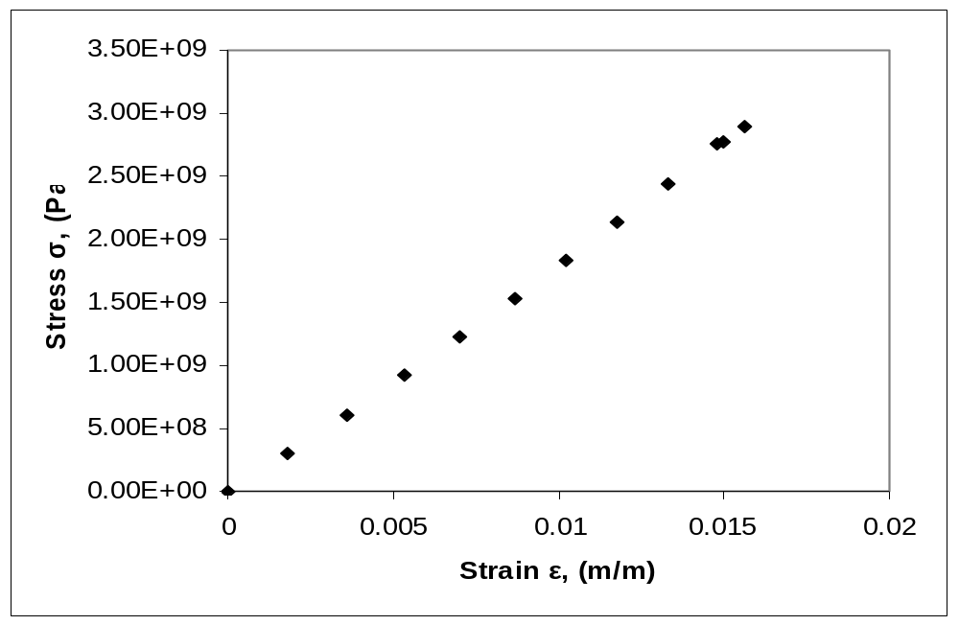
Example 2 Results
How well the equation
describes the data?
Figure. Linear regression for Stress vs. Strain data

Slide 25
Goodness of fit
In all regression models one is solving an overdetermined system of equations, i.e., more equations than unknowns.
How good is the fit?
  Often based on a
  coefficient of determination, r²

Slide 26
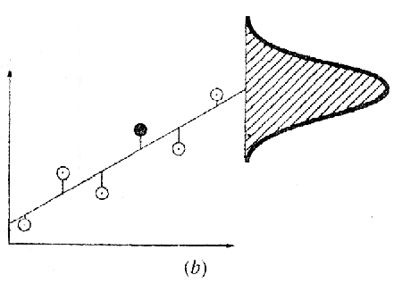
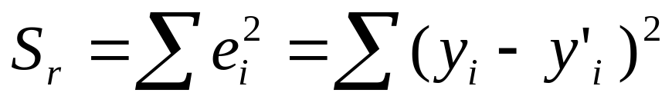
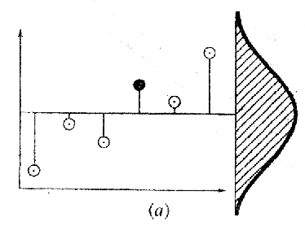
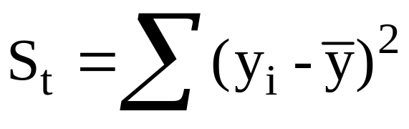
Goodness of fit
r² Compares the average spread of the data about the regression line compared to the spread of the data about the mean.
Spread of the data around the regression line:
Spread of the data around the mean:

Slide 27
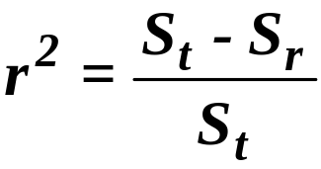
Coefficient of determination
describes how much of variance is “explained” by
the regression equation
Want r² close to 1.0; r² ≈ 0 means no improvement over taking the average value as an estimate.
Doesn't work if models have different numbers of parameters.
Be careful when using different transformations – always do the analysis on the untransformed data.

Slide 28
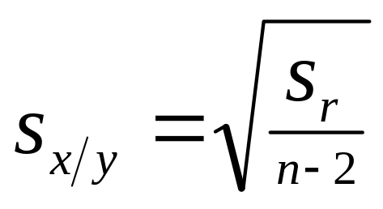
Precision
If the spread of the points around the line is of similar magnitude along the entire range of the data,
Then one can use
= standard error of the estimate
(standard deviation in y)
to describe the precision of the regression estimate

